Slide 1
电池生命周期管理系统
Comprehensive Design
Mar 15，2024
小组成员：王浩羽、李宗润、徐涵
指导老师：卢周广

Slide 2

Outline
Background and Significance
Objectives
Plan
Progress report

Slide 3
Computer Science Part 王浩羽
Goals and Objectives
Proposed Methods
Data Exploration
Data Processing
Experimental Results
Future Works

Slide 4
Outline – Computer Science
Goals and Objectives
Proposed Methods
Data Exploration
Data Processing
Experimental Results
Future Works

Slide 5
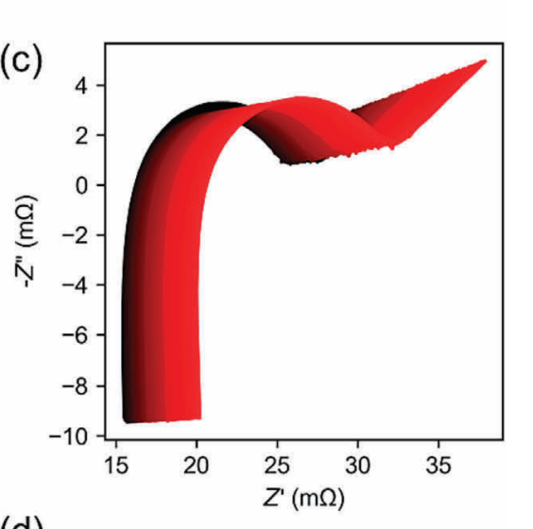
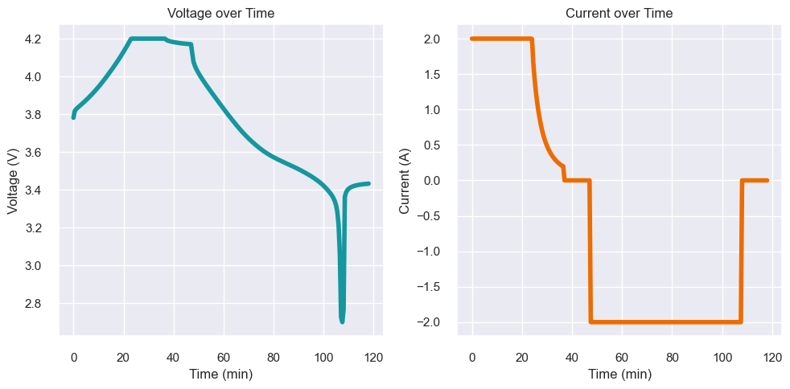
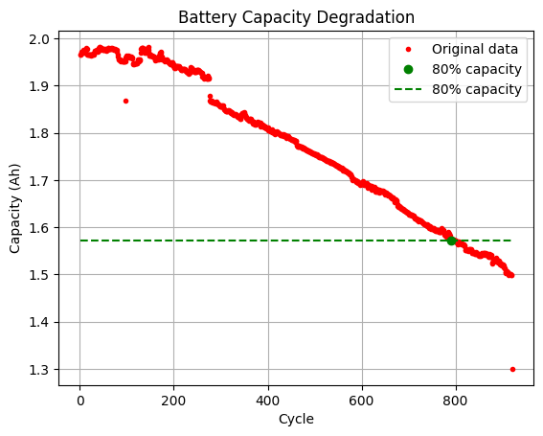
Goals and Objectives
Based on charging curves
and EIS curves
Predict battery Remaining Useful Life (RUL)
Capacity decreases to 80% of original capacity

Slide 6
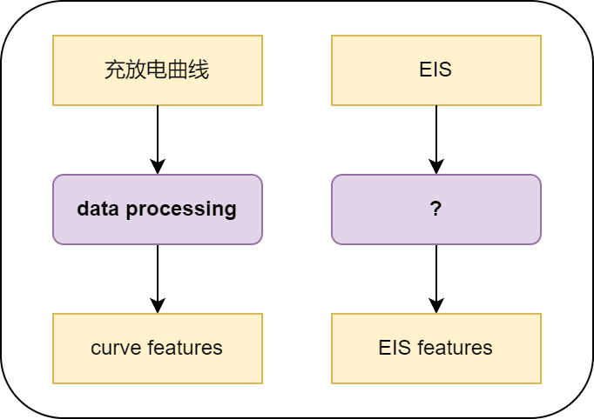
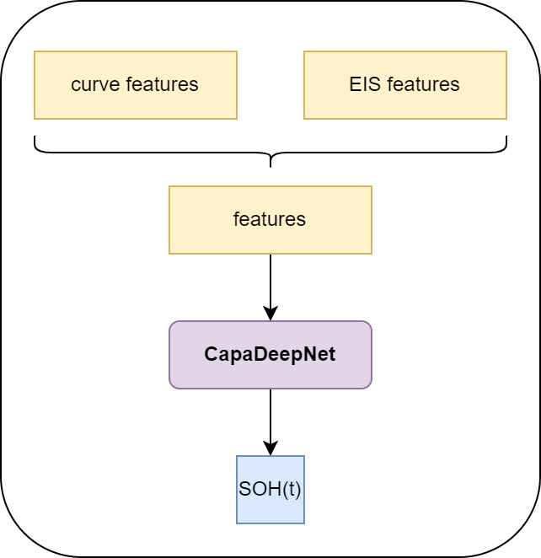
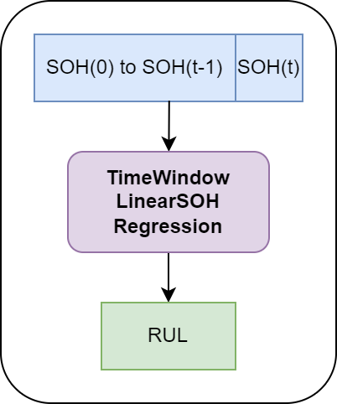
Proposed Methods
Step1
Data Processing
Step2
Predict SOH(t)
Step3
Estimate RUL

Slide 7
Data Exploration
Datasets:
6 battery already have
2 battery in future
battery | charging protocol | CC current | CV voltage | cycle
0 | CC-CV | 2.0A | 4.2V | 584
1 | CC-CV | 2.0A | 4.2V | 642
2 | CC-CV | 2.0A | 4.2V | 584
3 | CC-CV | 3.0A | 4.2V | 679
4 | CC-CV | 3.0A | 4.2V | 920
5 | CC-CV | 3.0A | 4.2V

Slide 8
Data Exploration
Data in datasets:
Battery charging curves
(1 curve per cycle)
Battery EIS curves
(1 curve per 10 cycle)
Discharging capacity

Slide 9
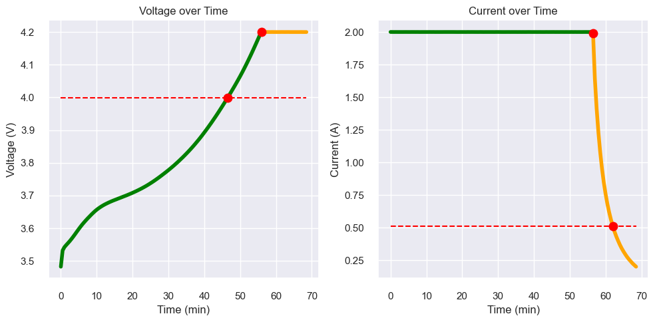
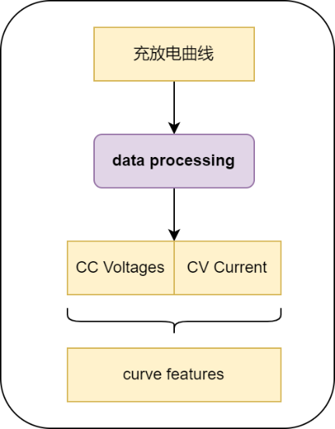
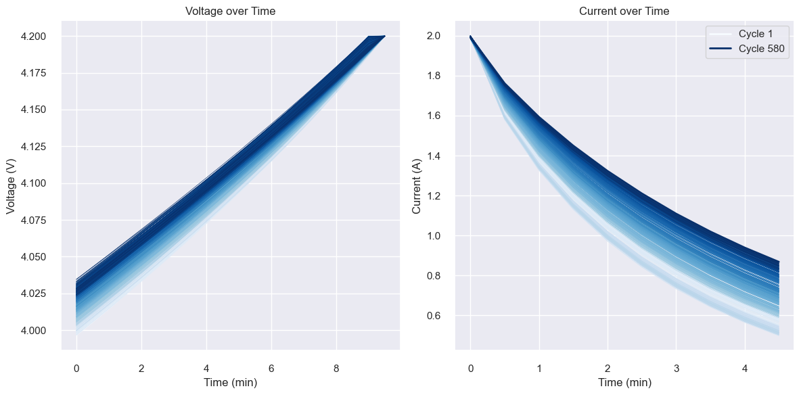
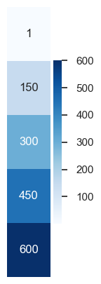
Data Processing
Step1: Data Processing
CC Voltage
CV Current
CC
Voltage
Sample points number
CC -> U: 4.0V ~ 4.2V; I=2.0A
CV -> I: 2.0A ~ 0.5A; U=4.2V
Sample points number
CC Voltage: 20
CV Current: 10
CV Current

Slide 10
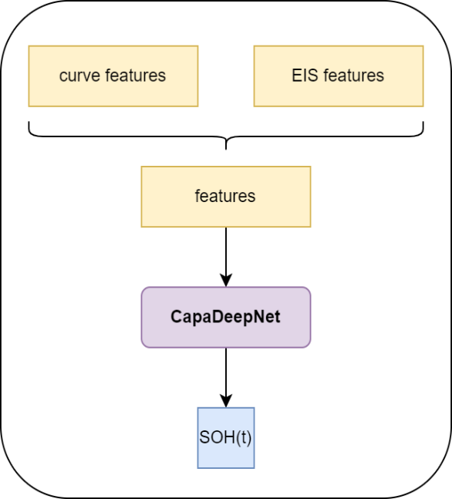
Experimental Results
Step2: CapaDeepNet
Integrative Deep Neural Net of Charging Profiles and Electrochemical Impedance Spectroscopy for Precise Battery Capacity Prediction
DeepNet Structure:
Hyper Params:
Epoch：50
Batch Size：16
 | layer | in-dim | out-dim
1 | FC | 30 | 32
2 | FC | 32 | 64
3 | FC | 64 | 72
4 | FC | 72 | 128
5 | FC | 128 | 64
6 | FC | 64 | 64
7 | FC | 64 | 32
8 | FC | 32 | 16
9 | FC | 16 | 8
10 | FC | 8 | 1

Slide 11
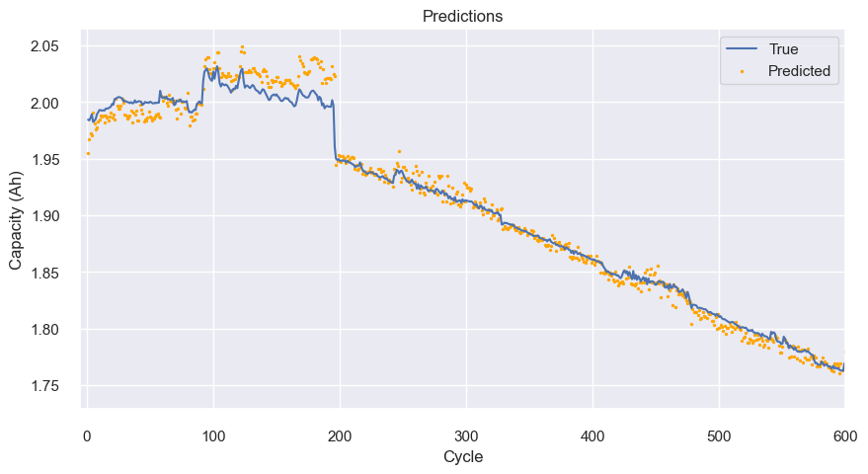
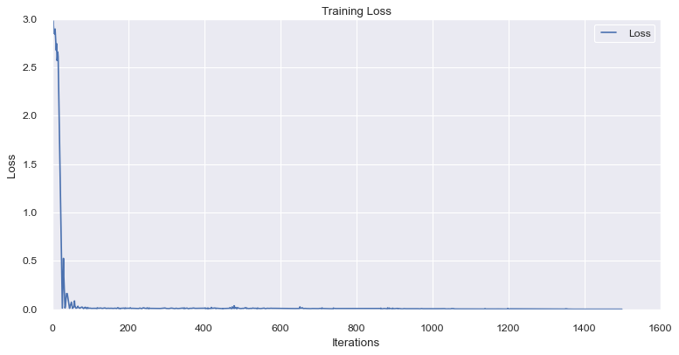
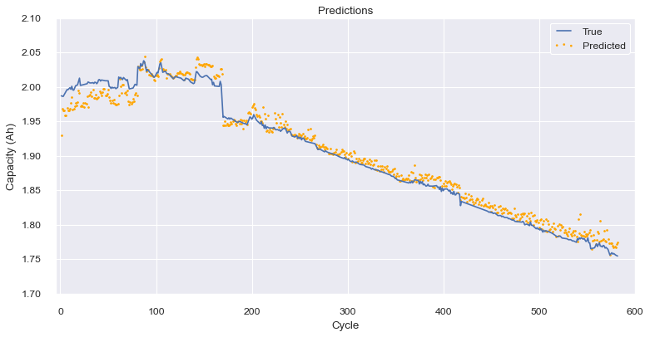
Experimental Results
Step2: CapaDeepNet Results
Battery 0: Training Data
(training and validation)
Battery 1 and 2: Evaluation

Slide 12
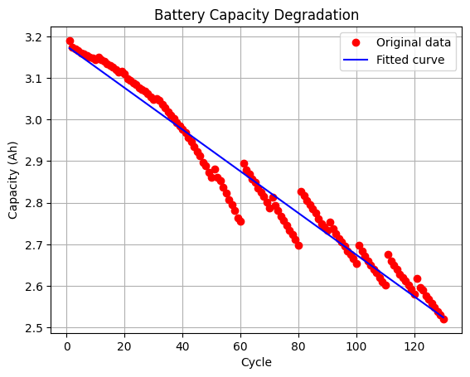
Experimental Results
Step3: TimeWindow LinearSOH Regression
Target: 80% capacity
Difficulty: Capacity Regeneration

Slide 13
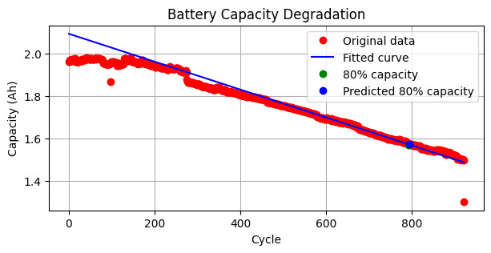
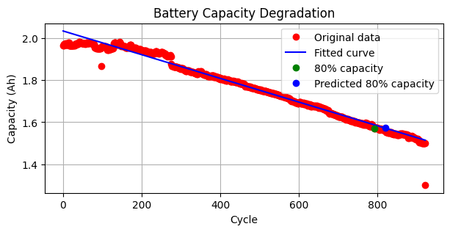
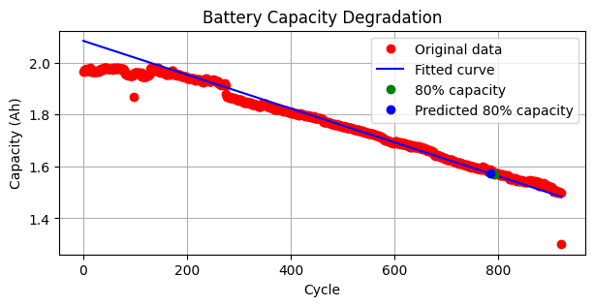
Experimental Results
Step3: TimeWindow LinearSOH Regression
Training data:
capacity of a time window
500-600
Time Window Size: 100
Step: 50
550-650
600-700

Slide 14
Future Works
To enhance the accuracy and applicability of our model
Expanding Battery Testing Scope: Testing and Analysis across Various Battery Types
Refined Feature Extraction from Electrochemical Impedance Spectroscopy (EIS) curves
Plan | Time Frame
Evaluate proposed methods on 6 datasets we already had | 3.18 – 3.31
Refine EIS features extracting | 4.1 – 4.14
Evaluate with refined methods | 4.15-4.28
Prepare materials | 4.29 -

Slide 15
Reference
1．Wang, S., Jin, S., Bai, D., Fan, Y., Shi, H., & Fernandez, C. (2021). A critical review of improved deep learning methods for the remaining useful life prediction of lithium-ion batteries. Energy Reports, 7, 5562–5574. https://doi.org/10.1016/j.egyr.2021.08.182
2．Ansari, S., Ayob, A., Hossain Lipu, M. S., Hussain, A., & Saad, M. H. M. (2022). Remaining useful life prediction for lithium-ion battery storage system: A comprehensive review of methods, key factors, issues and future outlook. Energy Reports, 8, 12153–12185. https://doi.org/10.1016/j.egyr.2022.09.043
3．Wang, S., Jin, S., Deng, D., & Fernandez, C. (2021). A Critical Review of Online Battery Remaining Useful Lifetime Prediction Methods. Frontiers in Mechanical Engineering, 7. https://doi.org/10.3389/fmech.2021.719718
4．Park, K., Choi, Y., Choi, W. J., Ryu, H.-Y., & Kim, H. (2020). LSTM-Based Battery Remaining Useful Life Prediction With Multi-Channel Charging Profiles. IEEE Access, 8, 20786–20798. https://doi.org/10.1109/access.2020.2968939
5．Xu, Q., Wu, M., Khoo, E., Chen, Z., & Li, X. (2023). A Hybrid Ensemble Deep Learning Approach for Early Prediction of Battery Remaining Useful Life. IEEE/CAA Journal of Automatica Sinica, 10(1), 177–187.
https://doi.org/10.1109/jas.2023.123024
6．Lu, J., Xiong, R., Tian, J., Wang, C., & Sun, F. (2023). Deep learning to estimate lithium-ion battery state of health without additional degradation experiments. Nature Communications, 14(1). https://doi.org/10.1038/s41467-023-38458-w
7．Zhang, Y., Tang, Q., Zhang, Y., Wang, J., Stimming, U., & Lee, A. A. (2020). Identifying degradation patterns of lithium ion batteries from impedance spectroscopy using machine learning. Nature Communications, 11(1). https://doi.org/10.1038/s41467-020-15235-7

Slide 16
THANK YOU！

